Slide 1
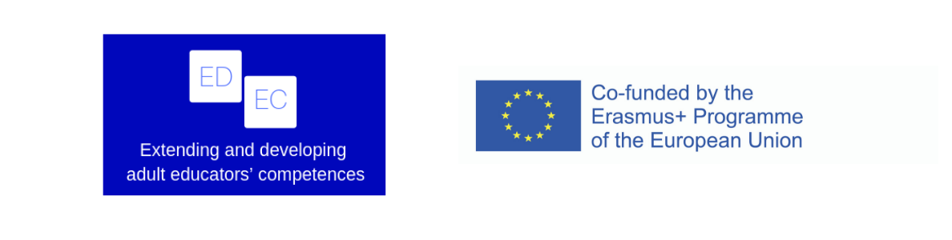
ADULT EDUCATOR - CHALLENGES AND TRENDS
The UK
Simon Dawson

Slide 2
The Setting
The UK is a unitary parliamentary democracy and constitutional monarchy
A nation of states and not a nation state
  England
  Scotland
  Wales
  Northern Ireland
Each state is responsible for their own educational systems

Slide 3
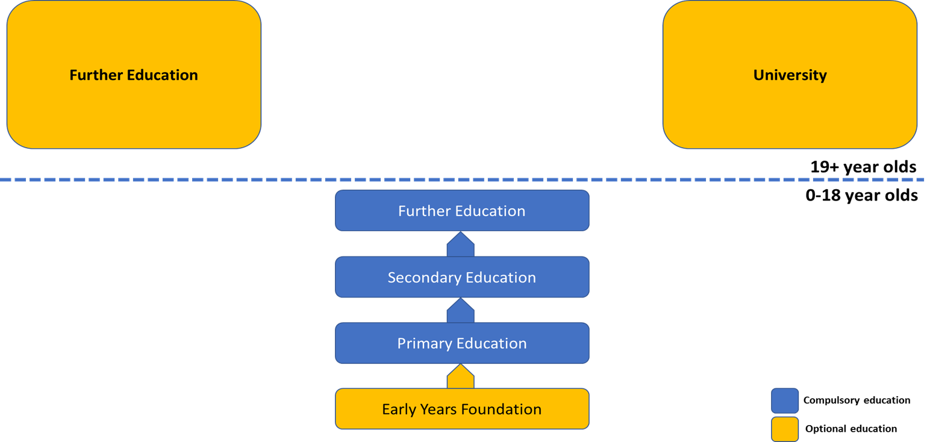
English Educational System

Slide 4
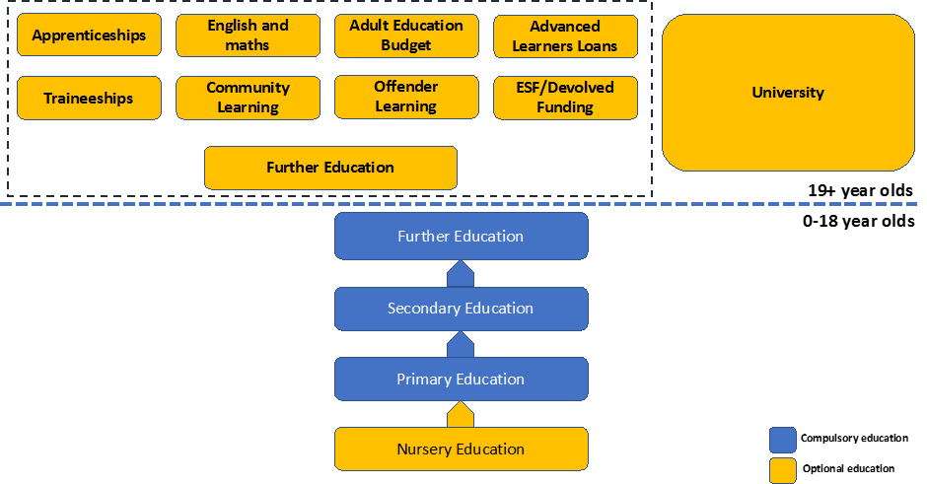
English Educational System

Slide 5
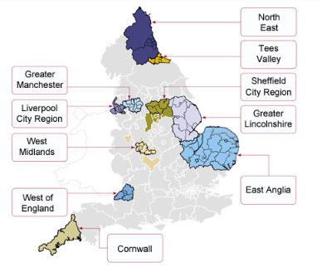
English Educational Devolution

Slide 6
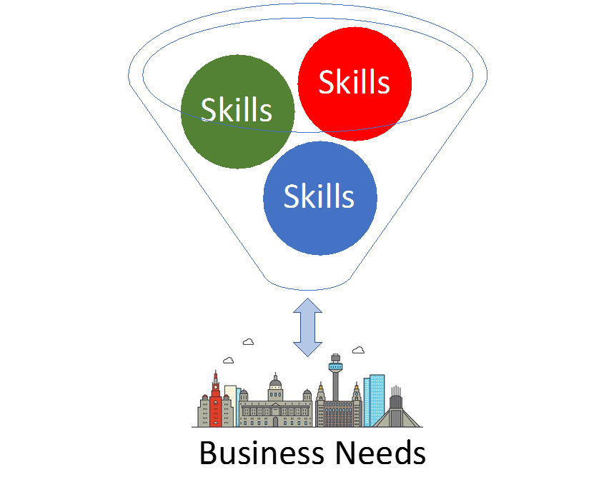
English Educational Strategy

Slide 7
English Educational Strategy
Great complexity of training offer
Great complexity of business needs

Slide 8
Educational & Vocational Counsellors
No national team of educational & vocational counsellors
Training packages are trainee-led

Slide 9
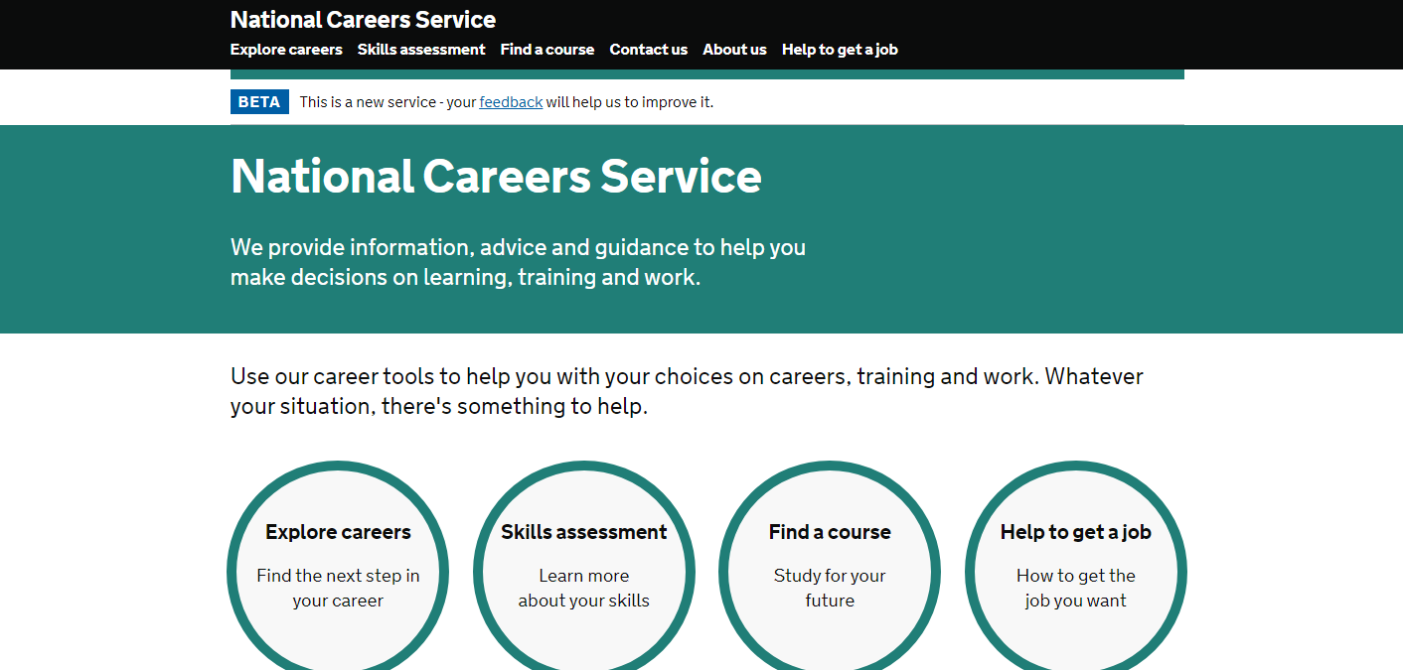
Information Systems

Slide 10
Information Systems
Accuracy ?
Timeliness ?

Slide 11
Skills Brokers
No national skill broker service
Locally funded, employer-led Skills Brokers
  Level 4 Information, Advice & Guidance or Degree
  Practical industry experience
  Negotiation skills
  Financial management skills
  Understanding of Government policy and legislation
Lack of trainee-led Information, Advice & Guidance

Slide 12
Matrix Standard
Quality Standard
  Leadership & Management
  Resources
  Service Delivery
  Continuous Quality Improvement

